Slide 1
Blue Planet Hackathon
APAC Use Case overview
Andrew Roberts, Manoj Regmi
April 2016

Slide 2
Objectives
Build targeted use cases that can be demonstrated to customers
Enterprise to Data Centre Connectivity
Cloud-Connect
DC-I
Build Portal / Application that can be ‘skinned’ to demonstrate different Use Cases
Mobile Backhaul Use Case
Packet
Enterprise vertical

Slide 3
Tasks
User Interface / App – Andrew, Agatsuma
Resource Adapters
3900 (or 5160?) (Tim, Vikas)
WaveServer (Manoj RAs; REST)
Brocade vRouter (or equivalent) (Agatsuma, Mitchell)
Service Template(s)
Hardware
2 x 3900s
2 x WaveServers
PCs (to show connectivity x 4) or equivalent (e.g. test sets)

Slide 4
Tasks
User Interface / App
Services
Waveserver
10G P2P service
3900
P2P MPLS-TP service
Bandwidth / QoS configuration
Virtual Router (Juniper?)
Cross-connect
Bandwidth mediation
Resource Adapters
3900
WaveServer
Brocade vRouter (or equivalent)
Service Template(s) ??

Slide 5




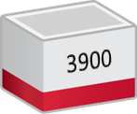

High-level topology
Portal
MDSO
RA
RA
RA
Enterprise site
AWS
PC3
Brocade vRouter
PC1
Azure
PC2
Data Centre 1
PC4
Data Centre 2

Slide 6
Use Case 1: Enterprise to DC
Portal
Customer accesses Portal & requests access to DC1
2
MDSO
BP Orchestrated connection across 3900s
1
RA
RA
RA
Enterprise site
AWS
PC3
Brocade vRouter
PC1
Azure
PC2
Data Centre 1
PING
3
Ping PC1-PC2 to test connectivity
PC4
Data Centre 2

Slide 7
Use Case 2: Cloud Connectivity
Portal
Customer accesses Portal & requests 100Mbps to AWS
2
MDSO
BP Orchestrated connection across 3900s + Brocade vRouter
1
RA
RA
RA
Enterprise site
AWS
PC3
Brocade vRouter
PC1
Azure
PC2
Data Centre 1
PING
3
Ping PC1-PC3 to test connectivity
PC4
Data Centre 2

Slide 8
Use Case 3: DC-I (possibly based on bandwidth trigger)
2
MDSO
Bandwidth trigger to BP (TBD???)
BP Orchestrated connection across 3900s, + Brocade + WaveServer
RA
RA
RA
1
Enterprise site
AWS
PC3
Juniper vRouter
PC1
Azure
PC2
Plug in QSFP
Service create between two waveservers
PING
Data Centre 1
3
Ping PC1-PC4 to test connectivity
PC4
Data Centre 2

Slide 9

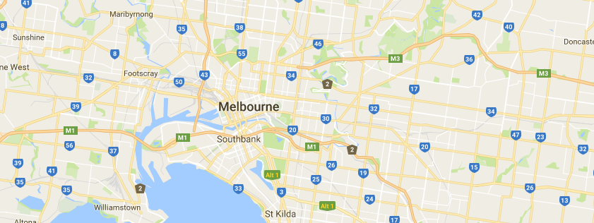




UI – Home Screen
Service Console
Create
Sites
Services
Service ID | From | To | Description | Action
x123456 | Enterprise 1 | DC1 | Connection from Ent to DC
X234567 | Enterprise 1 | AWS | 10Mbps Cloud Connect
x345678 | Enterprise 1 | DC2 | Triggered DC-I
i
x
i
x
i
x
Copyright
UI Option

Slide 10



Graphics
Home
Administration
Exit
Logs
i
i

Slide 11












Main menu - square
i
i

Slide 12












Main menu - circular
i
i

Slide 13








Users

Slide 14

Service constructs

Slide 15




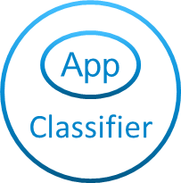








VNFs / Services
vEPC
Cloud
VR
App
Classifier
DPI
Connect
vEPC
Cloud
VR
App
Classifier
DPI
Connect

Slide 16




























Sites
Site
Residential
Office Tower
Factory
Retail
Core Site
Radio Site
Warehouse
Exchange
Data Centre
EPC
EPC

Slide 17





End-point types
End
Point
End
Point
EP
EP
App
+
+
App
App

Slide 18






Cell
ECP / Core
Office
Data Centre

Slide 19





Application types
Cloud
WAN

Slide 20





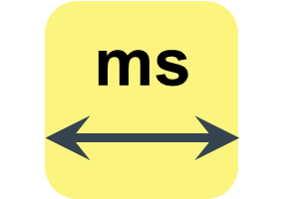

Tools
.cfg
✓
ms
Ping

Slide 21

Application templates
Mobile Backhaul Connect
Connect my cell sites
Office Connect
Connect my Office to my Data Centre
Enterprise Connect
Connect my Offices
Data Centre Connect
Connect my Data Centres

Slide 22
Application templates - grey

Slide 23
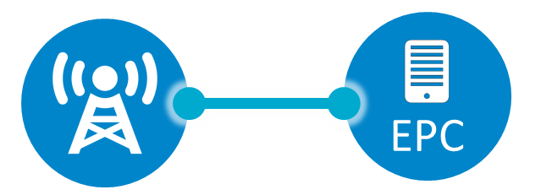
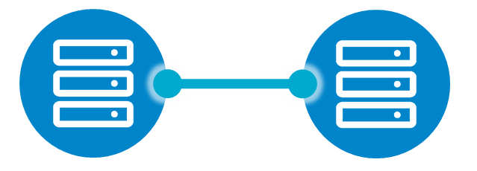



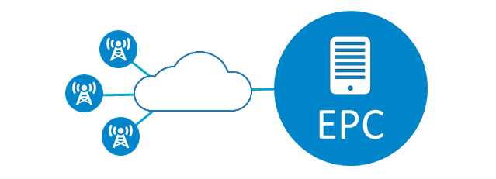
Application templates - grey

Slide 24
Application templates - bitmaps

Slide 25
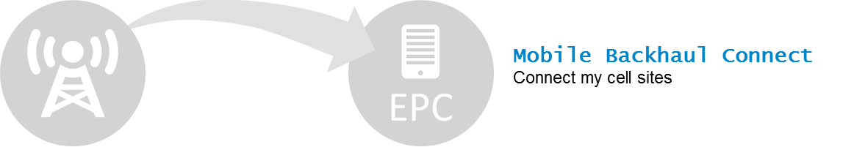



Application templates – bitmaps grey

